Slide 1
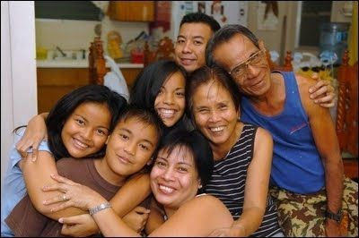
Building Strong Families for the Last Days

Slide 2
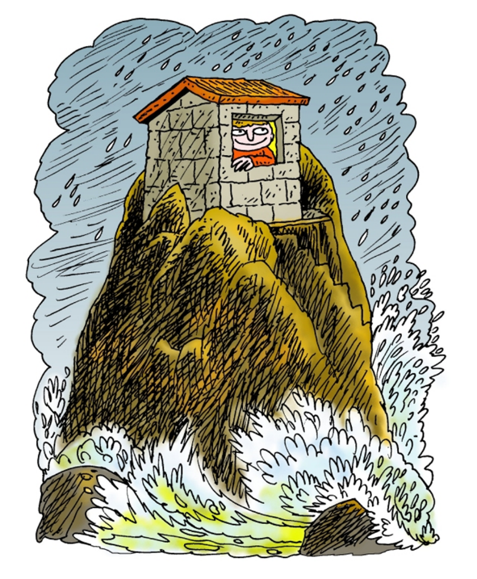
In Matthew 7:24-27, Jesus said we need build our house on solid rock- because the storms are coming!
foundation)

Slide 3
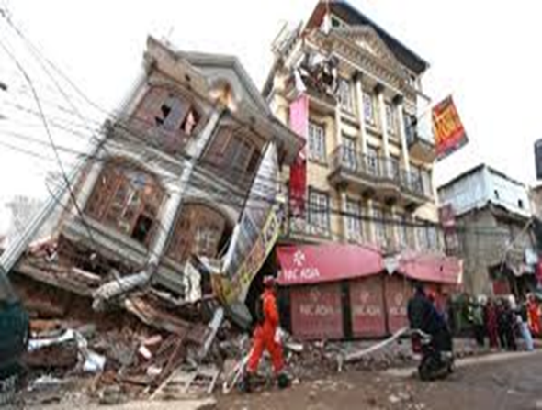
Christ also warned us that the world will have great trouble before His Second Coming- troubles that are already starting in some areas of the world!
“I will shake all nations, and they shall come to the Desire of All Nations” –Hag.2:7

Slide 4
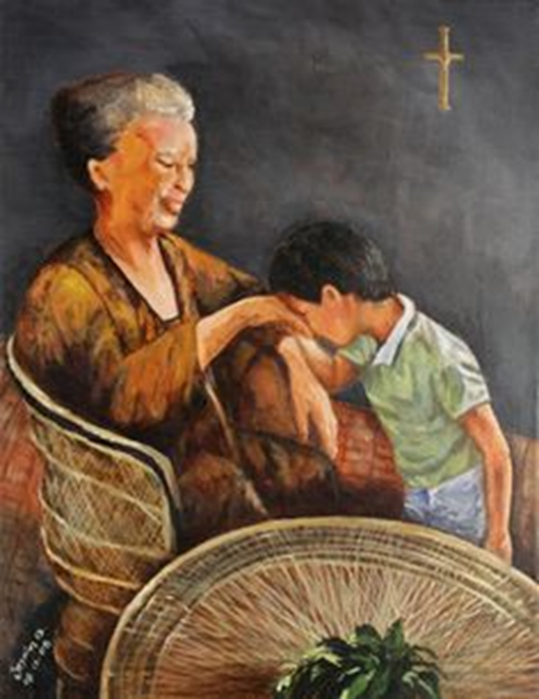
God’s blessings should be passed down through the generations- an inheritance that will last!

Slide 5
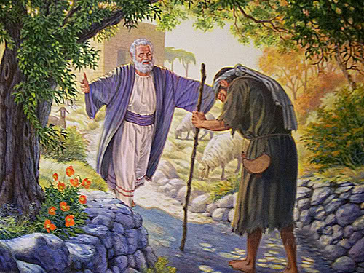
The Lord can help Parents who have had failures with their children

Slide 6
The Lord can help children who have seen their parents fail!
“And he will turn the hearts of the fathers to the children, and the children to their fathers, lest I come and strike the earth with a curse. -Malachi 4:6

Slide 7
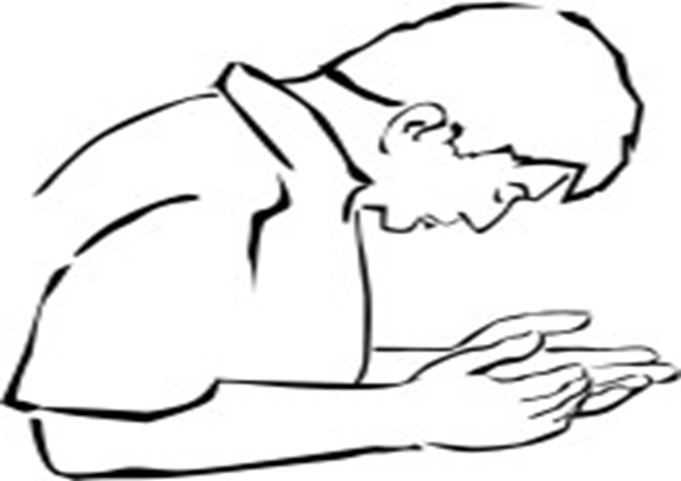
Pray!
“we do not fight against flesh and blood, but against principalities and powers…against spiritual hosts of wickedness in the heavenly places.” –Eph.6:12

Slide 8
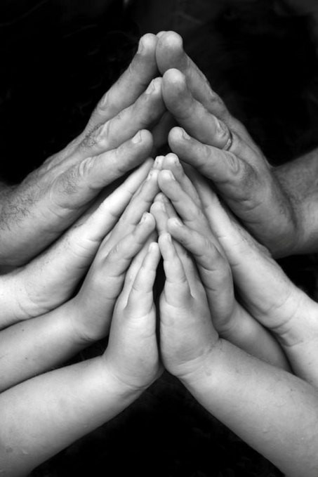
Job protected his family with his prayers. Job.1:5 & 1:9-10

Slide 9
Now, all of Job’s children are with him in heaven!
Job’s possessions before his trial, Job 1:2-3
-7000 sheep………………...
-3,000 camels……………….
- 500 yoke of oxen………..
- 500 female donkeys……
- 7 sons & 3 daughters….
Job’s possessions after his trial, Job 42:12-13
-14,000 sheep
- 6,000 camels
- 1,000 yoke of oxen
- 1,000 female donkeys
- 7 sons & 3 daughters
“And the Lord gave Job twice as much
as he had before” –Job 42:10

Slide 10
Continually Share God’s Word
“You shall love the Lord your God with all your heart…. You shall teach My words diligently to your children, and talk of them when you sit in your house, when you walk in the way,
when you lie down, and when you rise up…. You shall write them on your house and gates”
–Deut.6:5-9

Slide 11
WHEN YOU SIT IN YOUR HOUSE: Pray and read the Bible before meals, or during family gatherings
WHEN YOU WALK IN THE WAY: Talk about the Lord while you walk or travel together!
WHEN YOU LIE DOWN: Read a bedtime Bible story
WHEN YOU RISE UP: Teach your children to read the Bible every morning.
YOU SHALL WRITE THEM ON YOUR HOUSE AND GATES: Put Scriptures and Bible pictures in your house.

Slide 12
Discipline your children with words and actions
“The rod and rebuke give wisdom, but a child left to himself brings shame to his mother”-Prov.29:15

Slide 13
Give your time & your love to your children- build them up!

Slide 14
Build a strong family filled with God’s love- prepared for any difficulty!

