Slide 1
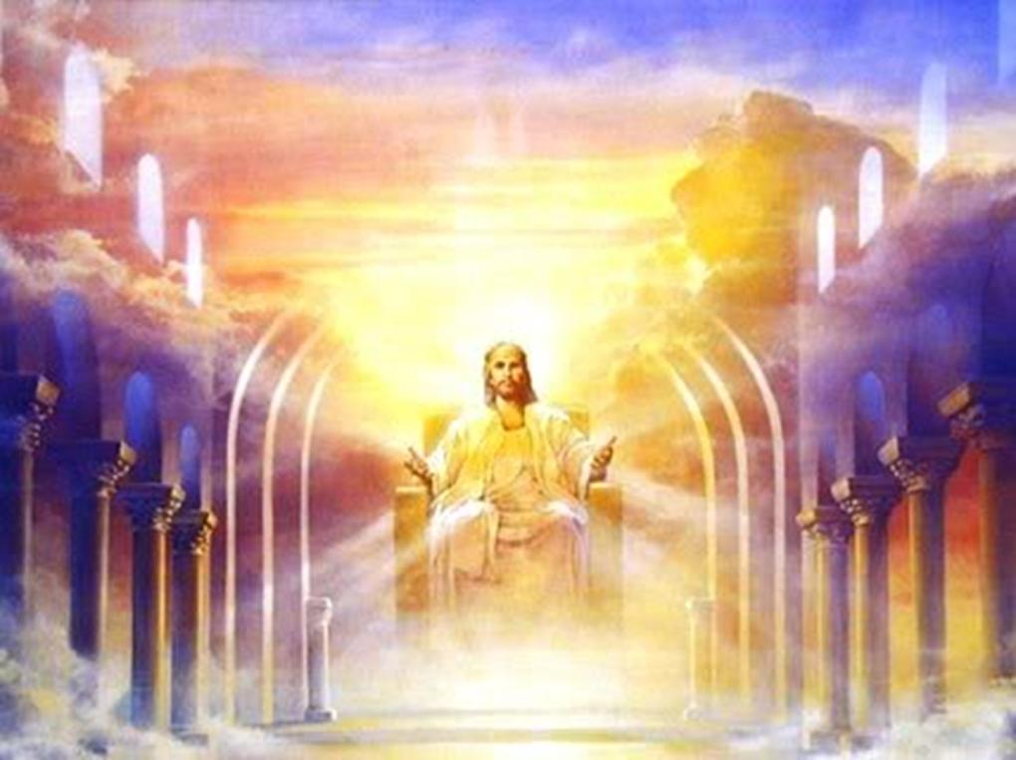
“…and has set down
at the right hand of
the throne of God.”
-Heb.12:2
The Triumph
of the Overcomers

Slide 2
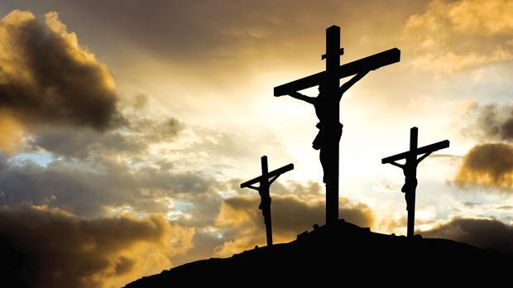
Christ triumphantly completed His race at the cross
“IT IS FINISHED!”

Slide 3
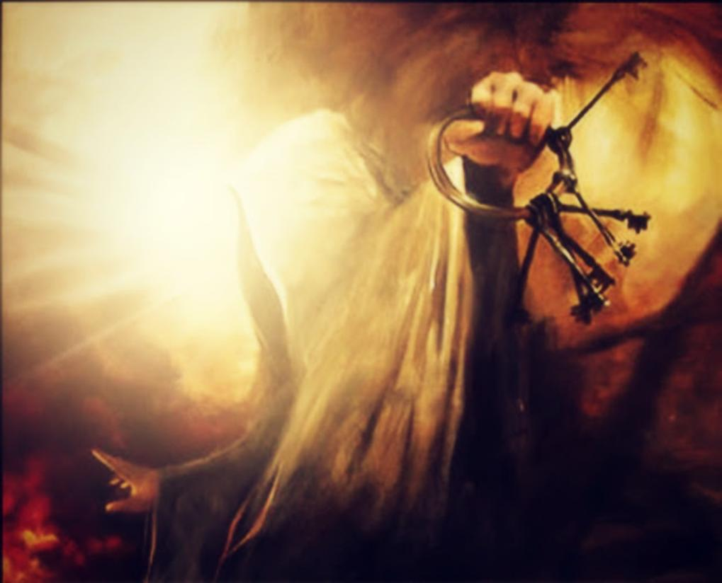
Proclaiming His victory, Jesus rose again with the keys of death and hell!

Slide 4
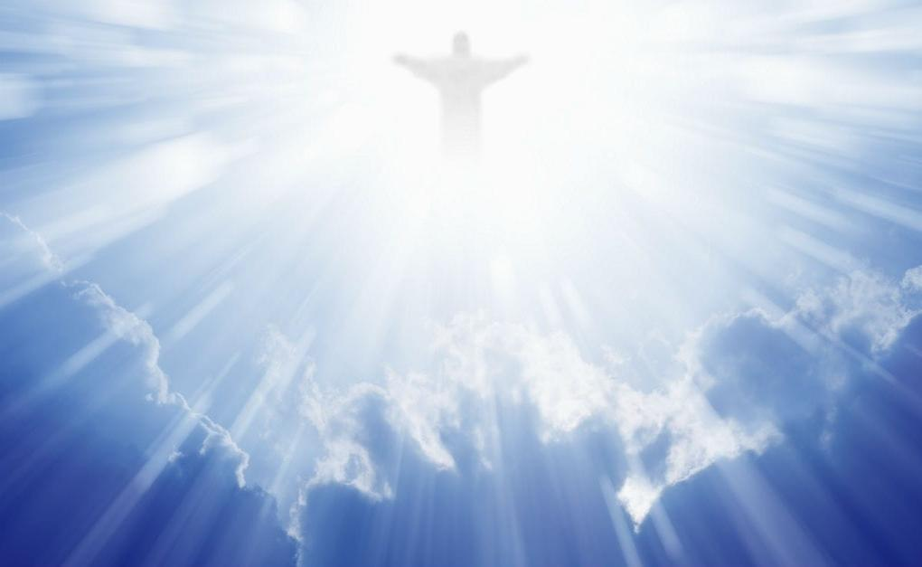

Slide 5
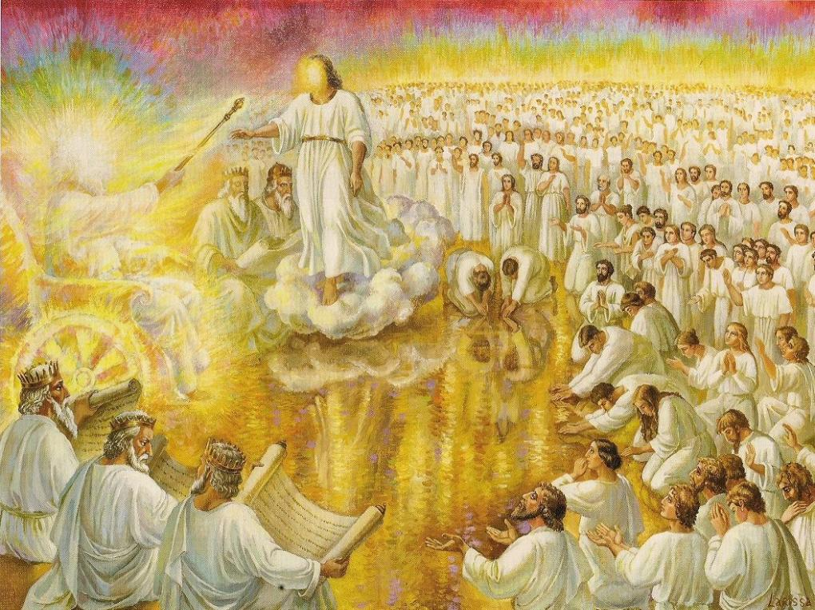
I saw in the night visions, and behold, One like the Son of man came with the clouds of heaven, and came to the Ancient of Days, and they brought Him near before Him. And dominion and glory was given Him, and a kingdom, that all peoples, nations and languages, should serve Him. His dominion is an everlasting dominion which shall not pass away, and His kingdom that which shall not be destroyed. -Dan.7:13-14

Slide 6
Christ has finished His race and is now seated on the throne of God
“And I looked, and behold, in the midst
of the throne…stood a Lamb” Rev.5:6

Slide 7
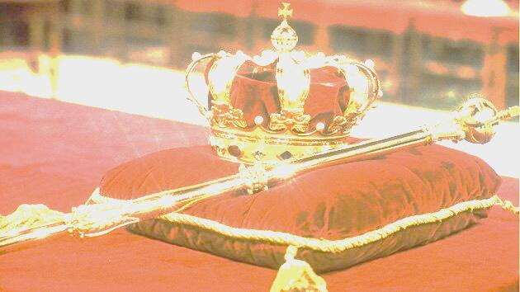
The Lord said to my Lord, Sit at My right hand until I place Your enemies as Your footstool. The Lord shall send the rod of Your strength out of Zion: rule in the midst of Your enemies. -Psalm 110:1-2

Slide 8
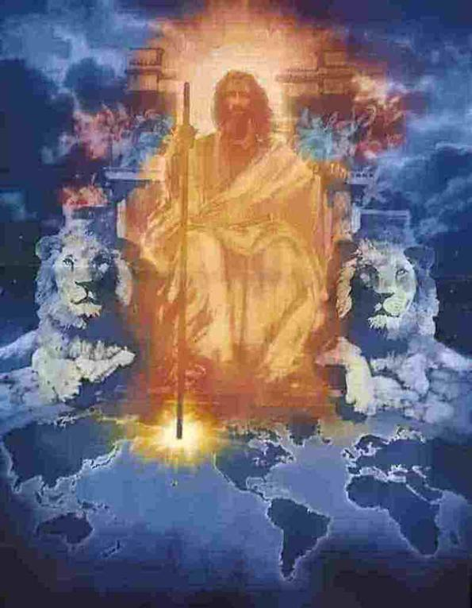
Christ is resting in His triumph, awaiting the timing of the Father, waiting for the full victory to be revealed
i

Slide 9
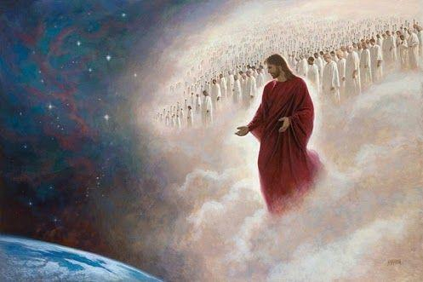
Waiting for His people to also finish their race & be prepared for His return

Slide 11
“Behold, I am coming quickly, and My reward is with Me, to give to every one according to his work.”
–Rev.22:12

Slide 12
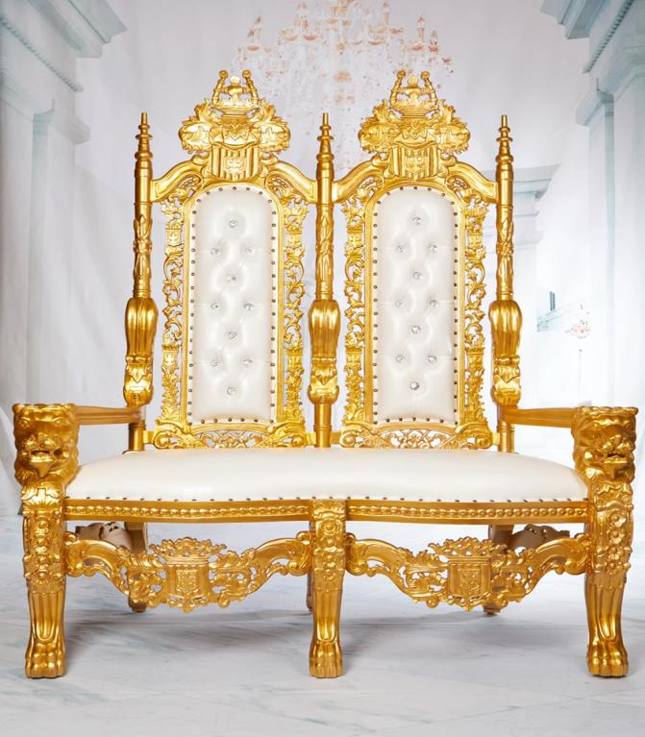
“To him who overcomes I will grant to sit with Me in My throne, even as I also overcame and have sat down with My Father in His throne.”
- Rev.3:21

Slide 13
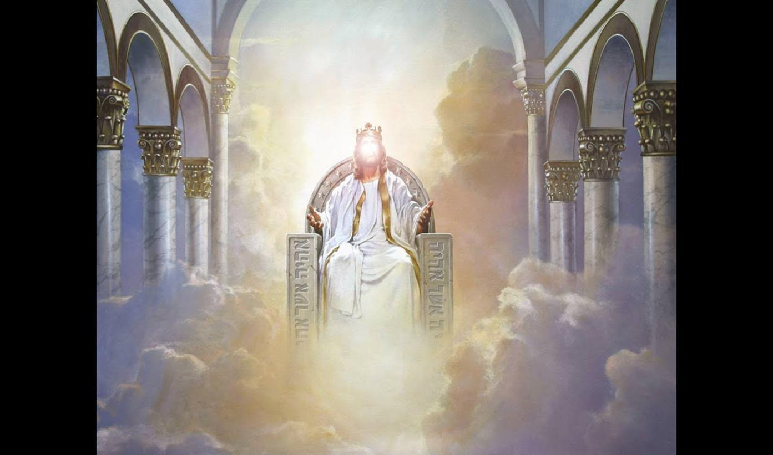
Christ will sit on His throne in Jerusalem for 1000 years as the King of kings!
“For the Lord Almighty will reign on
Mount Zion, in Jerusalem, and before
His elders- with great glory.” -Is.24:23

Slide 14
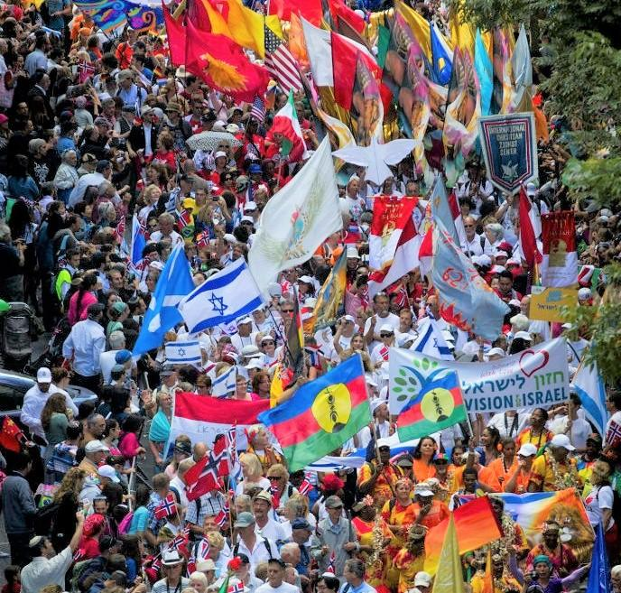
“And it shall be, everyone who is left of all the nations …shall go up yearly to worship the King, the Lord of Hosts, and to keep the Feast of Tabernacles.” –Zech.14:16

Slide 15
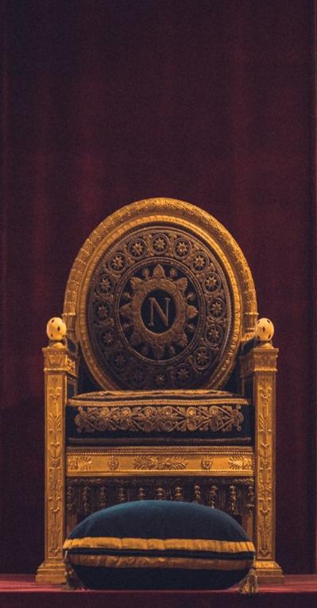
“and I saw thrones, and they sat on them…. they shall be priests of God and of Christ, and shall reign with Him a thousand years”
-Rev.20:4 & 6
-Those who finish their Christian race well will also share in His triumph!

Slide 18
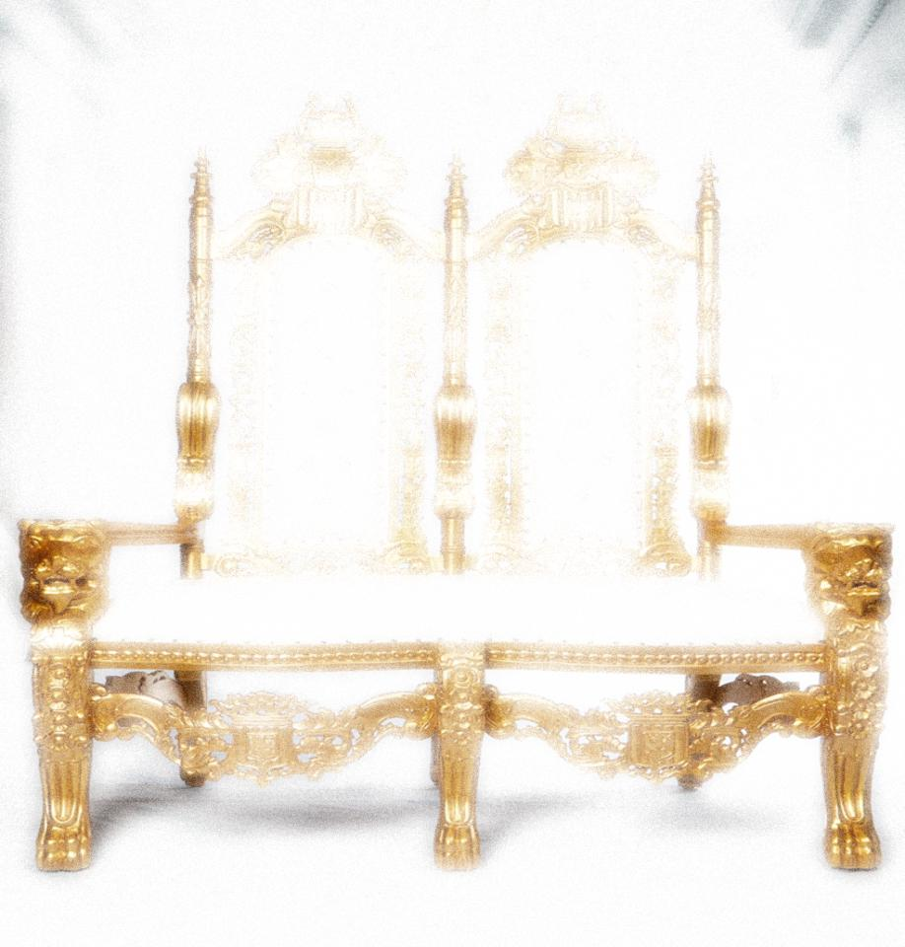
REIGNING WITH CHRIST 1. KING OF KINGS: Jesus! 2. KINGS- David, Joseph? Esther? 3. Governors- 12 Apostles & many others 4. MAYORS- multitudes of faithful
servants of God, Lk.19:17 & 19
5. LOCAL POSITIONS OF LEADERSHIP in each nation
MULTITUDES WILL ENTER THE TRIUMPH OF THE OVERCOMERS!

Slide 19
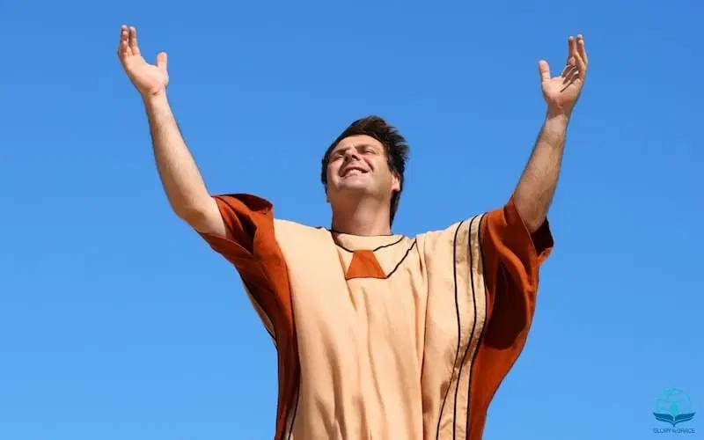
A KINGDOM OF PRIESTS
“And has made us a kingdom of priests”
-Rev.1:6

Slide 20
MANY VICTORIOUS CHRISTIANS WILL ALSO BE PRIESTS!
- To teach the people:
“For the priest's lips should keep knowledge, and they should seek the law at his mouth: for he is the messenger of the Lord of hosts.”
–Mal.2:7

Slide 21
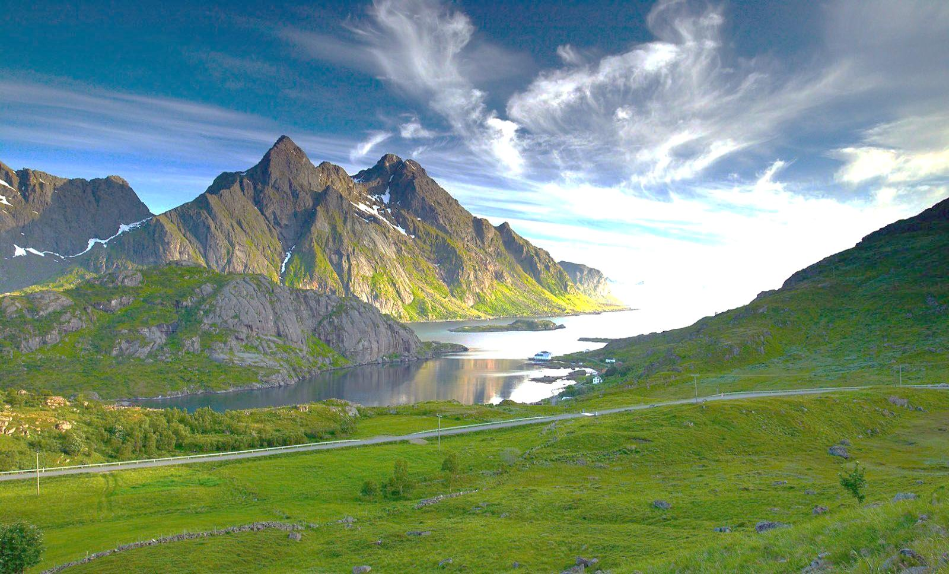
“And many people shall go and say, Come, and let us go up to the mountain of the Lord, to the house of the God of Jacob; and he will teach us of his ways, and we will walk in his paths: for out of Zion shall go forth the law, and the word of the Lord from Jerusalem.” -Isaiah 2:3
Zion has a calling to teaching- both now and in the Millennium!

Slide 22
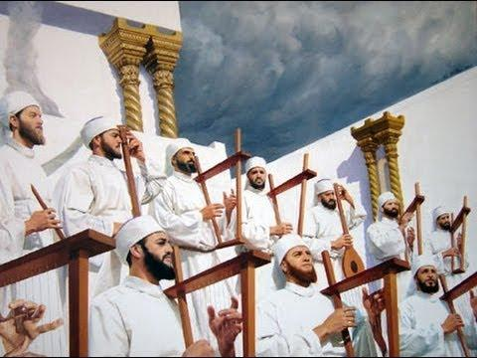
Priests lead the worship:
SONGLEADERS, MUSICIANS AND SINGERS
-in the Old Testament, all the singers and musicians were priests!

Slide 23
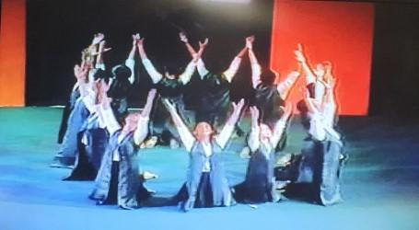
There will be worship celebrations!

Slide 24
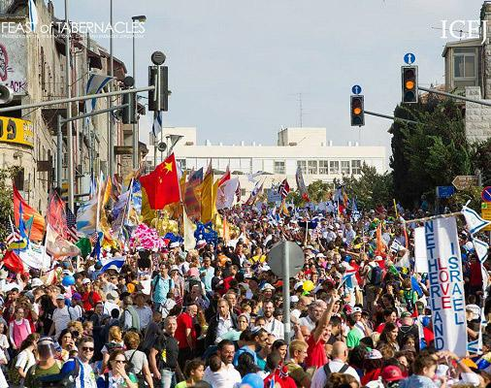
There will be Feasts to Celebrate!

Slide 25
maybe Christmas will be purified & celebrated!
Santa Claus
Nativity Scenes
Rudolph the Reindeer
Gift Giving
Frosty the Snowman
Christmas Carols

Slide 26
“And has made us kings and priests to our God, and we shall reign on the earth” -Rev.5:10

Slide 28
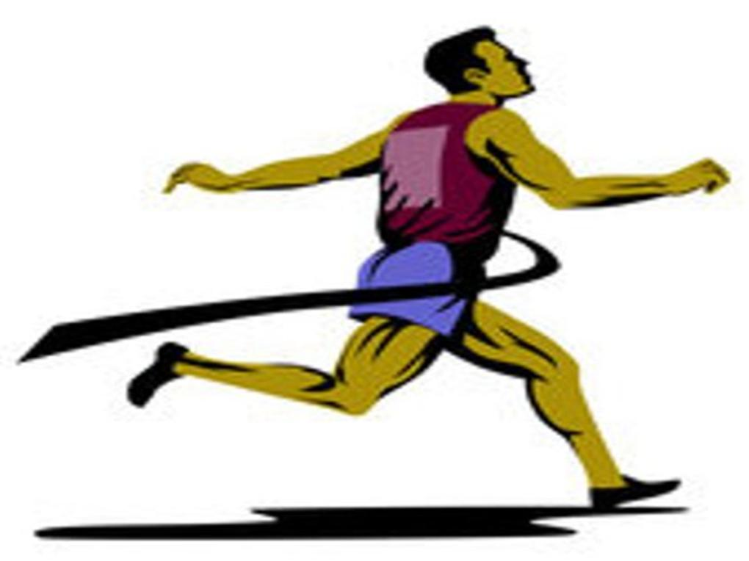
WE CAN ALL JOIN CHRIST & THE HEROES OF FAITH!
-overcome poor living conditions (Abraham)
-overcome health difficulties (Sarah)
-overcome persecution & accusation (Joseph)
-overcome worldly wealth & honor (Moses)
-overcome moral failure (Samson)
We all face similar difficulties
-but we can all win the race!

Slide 29
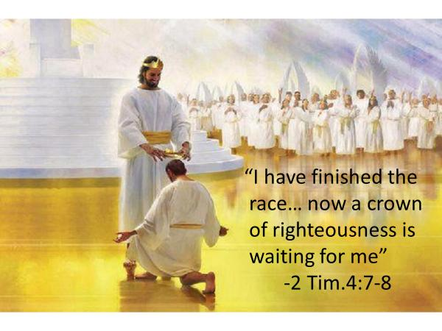
At the end of the race
may we all say, like Paul:

Slide 30
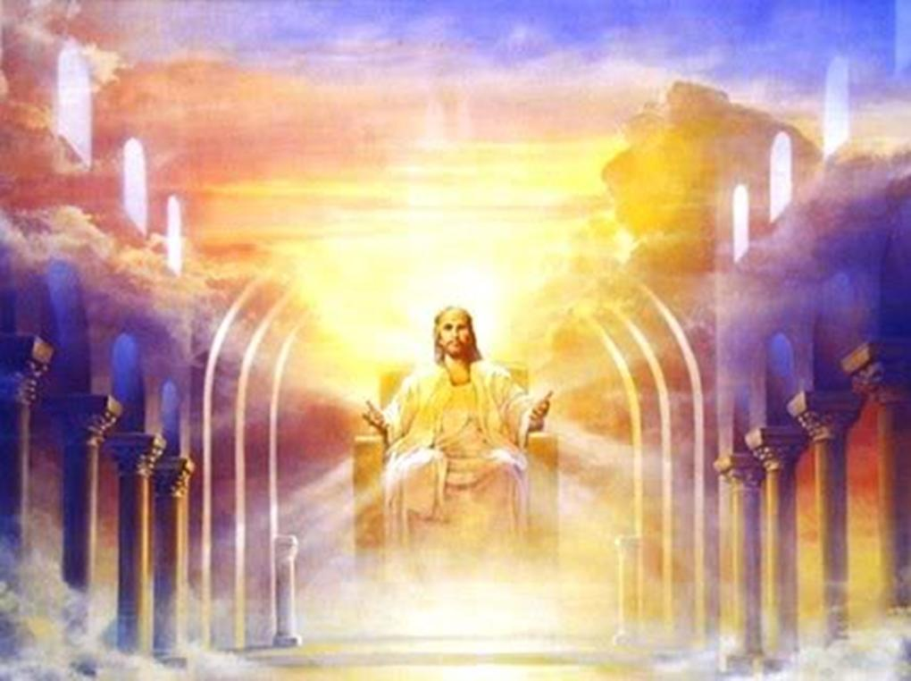
I have finished the race
and have entered my reward
Now YOU run the
race with endurance!

